Slide 1
Sociology

Slide 2
Sociology
Sociology
is the scientific study of human social behavior
of human social interaction
of how people behave in society
Society
is a group of people who live together in the same area
That interact
That share a government and dominant culture
Topics Include:
Culture
Crime
Economics
Education
Gender
Media
Politics
Race
Religion

Slide 3
Questions
How do societies hold together, what is the source of order?
What are the sources of conflict in society?
How did society come to be the way it is? How does society change?

Slide 4
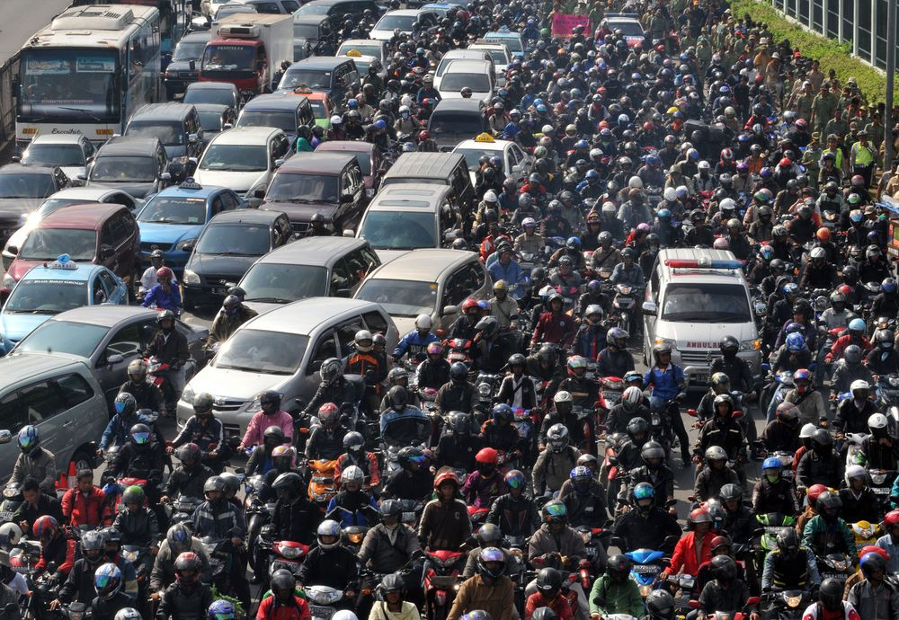
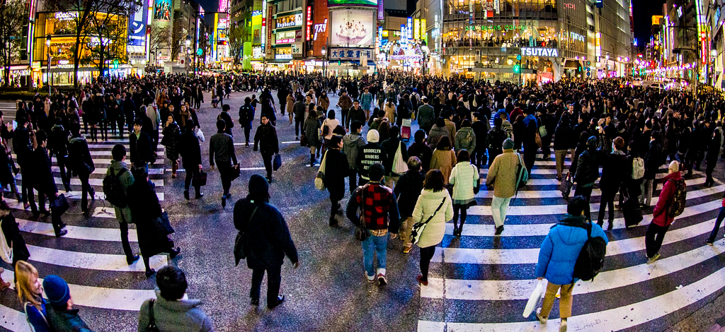
Order
What is the source of order in society?

Slide 5
Icebreaker Activity
Question: What controls behavior in society?
Social Behavior and Sanctions
In Groups
Describe the type of behavior shown in the photograph
Discuss the sanctions a person might get for that behavior
Do you agree with the sanction?
Write down your answers

Slide 6
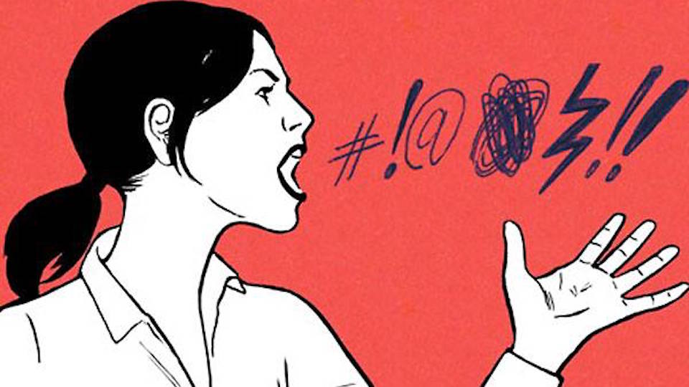

Slide 7
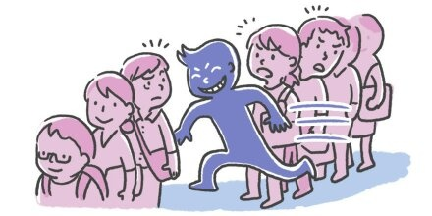

Slide 8
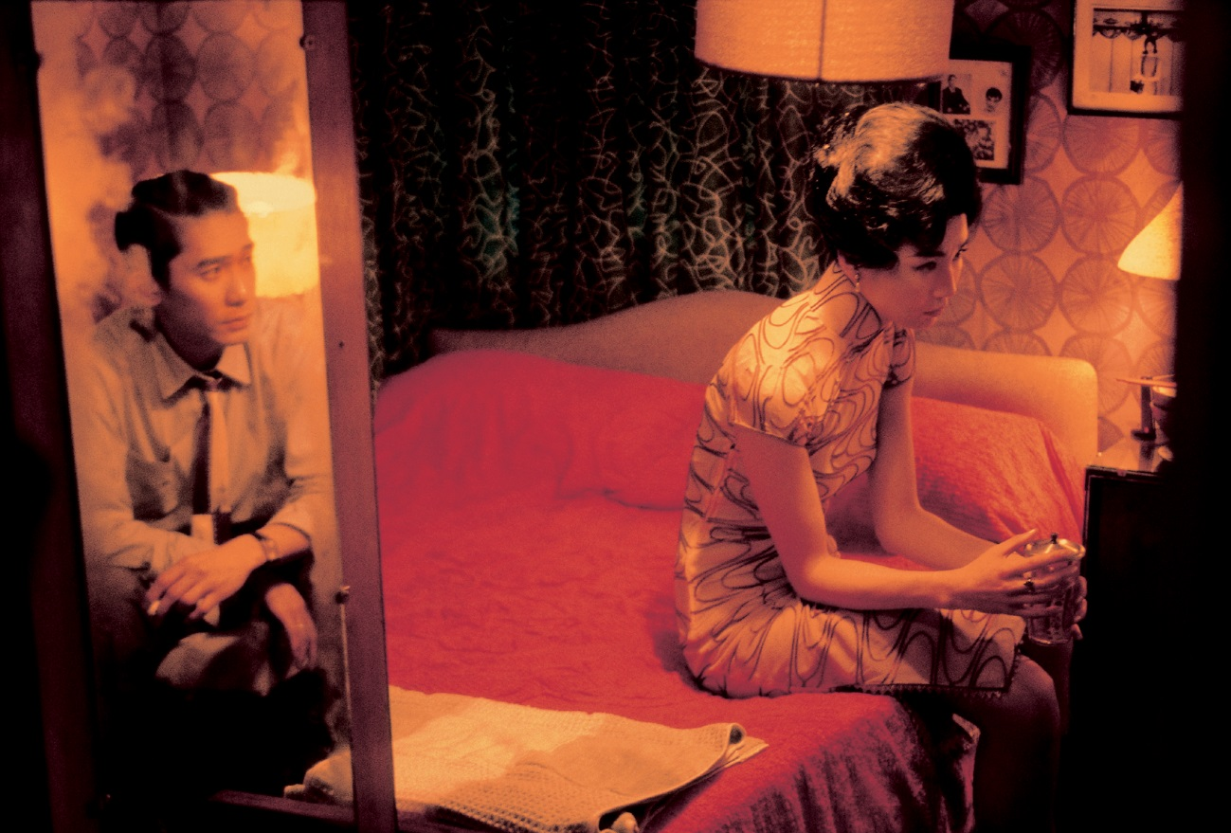

Slide 9
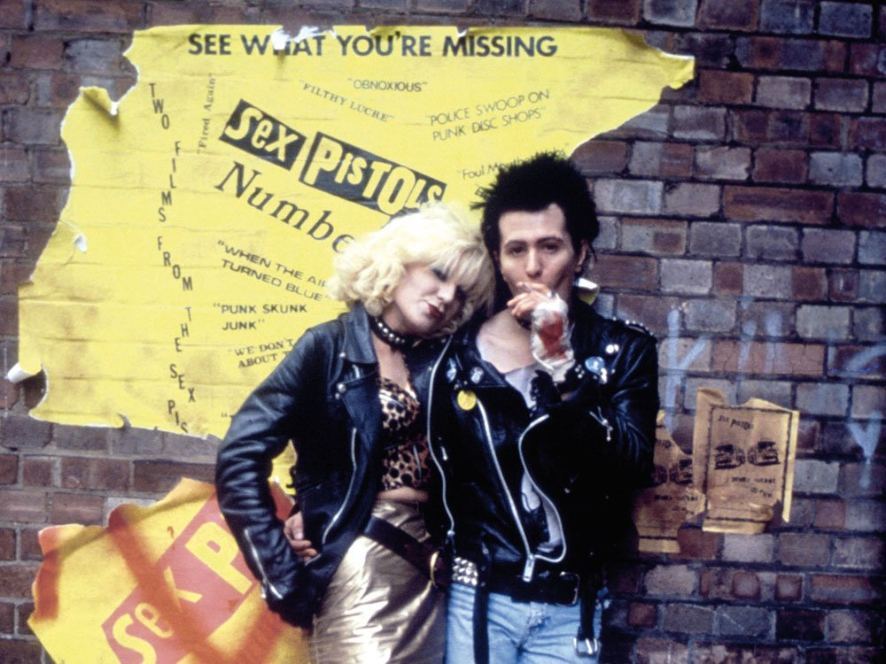

Slide 10
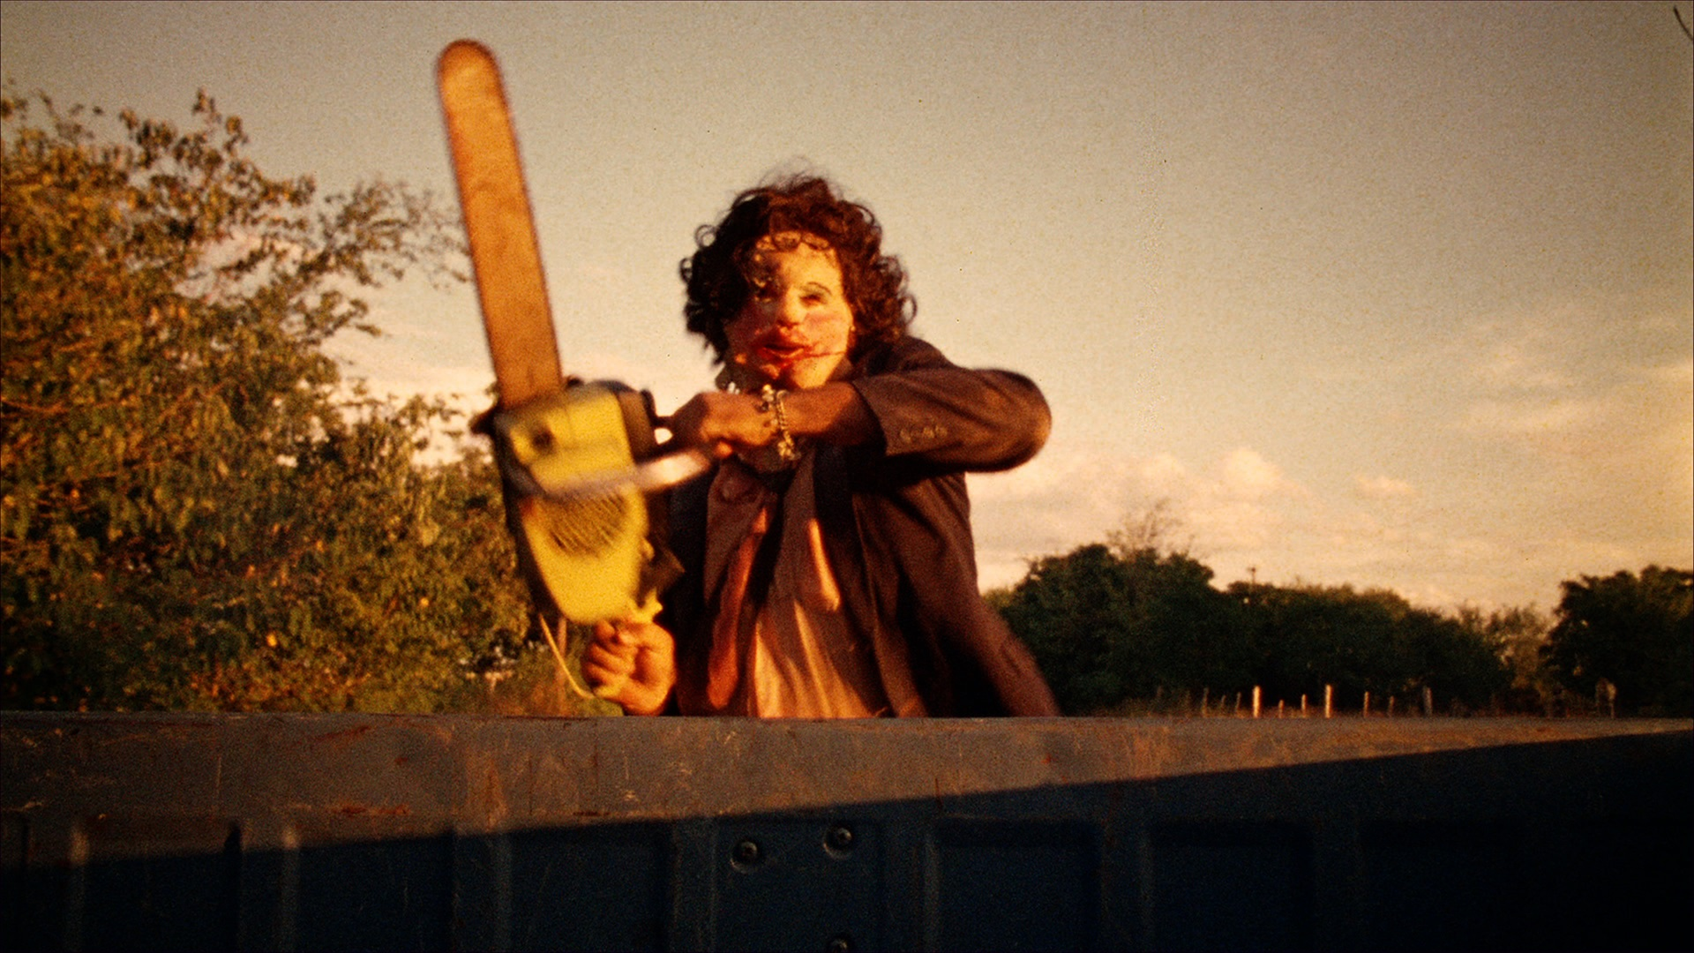

Slide 11
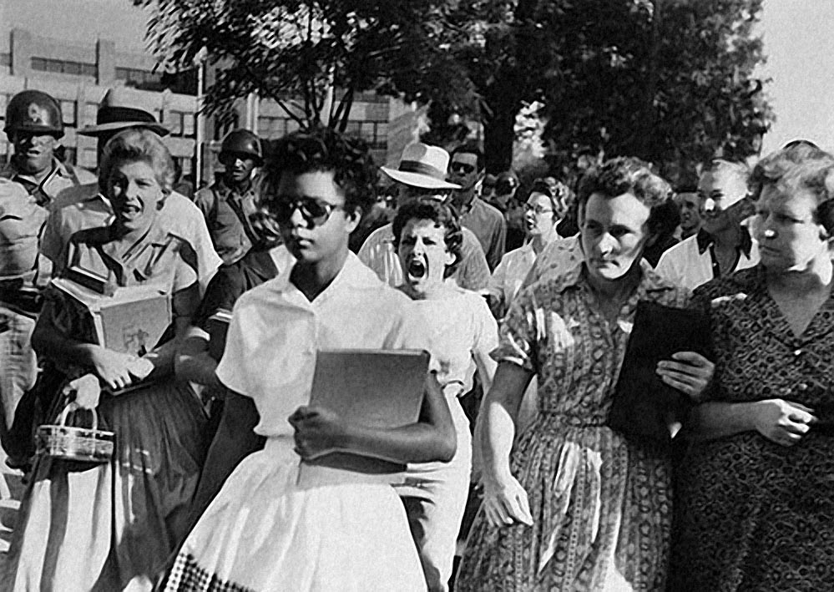

Slide 12
Institutions
What controls how we behave in society? Institutions!
Institutions can be anything that controls behavior in society
They can be formal or informal
Institutions:
Law
Family
Religion
Education
Family
Peer Groups
Economic Systems
Mass Media
Customs
Norms
Traditions

Slide 13
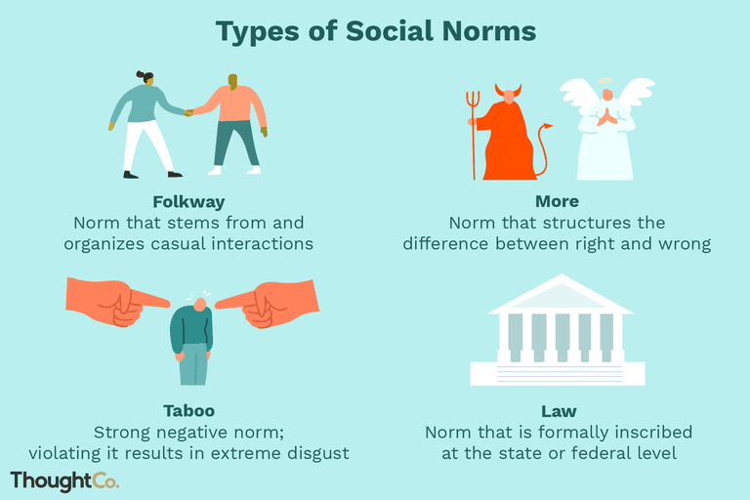
Social Norms
Norm – beliefs about how we should behave (what is acceptable and what is not)
Examples:
+ Shaking hands/Wai, Please & Thank You, washing, wearing clothes
- Cursing in public, cutting in line, talking to yourself, murder
Can be enforced formally or informally
Formally by the police and legal system
Informally by peers
Reward or Punish

Slide 14
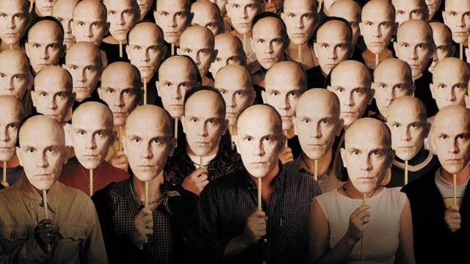
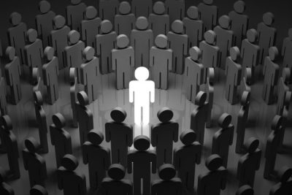
Conformity and Deviance
Conform
To behave in a socially accepted manner
To “fit in”
May be rewarded with acceptance by the group
Deviance
Behavior that is against social norms
May be punished with ostracism
Forced out of the group

Slide 15
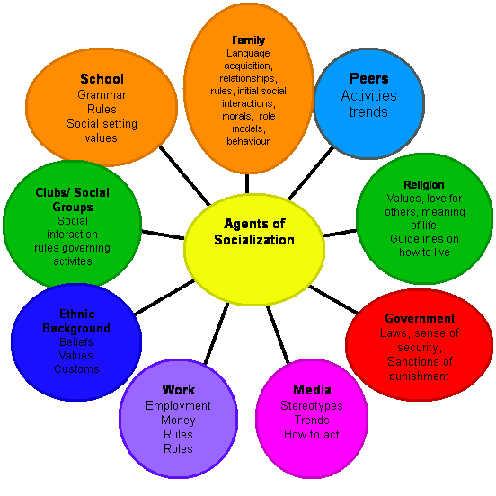
Socialization
Socialization is
The process of learning how to behave in society
How norms and culture are transmitted
Who or what socializes us?
Everything around us
Family
School
Religion
Peers
Government
Media
Work
Ethnic Background
Social Groups

Slide 16
Vocabulary
Institution – Structures or mechanisms of social order (anything that controls behavior in society)
Law – a system of rules created and enforced by a government (norms made into law)
Norm – beliefs about how we should behave (what is acceptable and what is not)
Socialization – the process of learning how to behave in society

